Slide 1
Building Applications for Relativity and RelativityOne

Slide 2
Chandra Alimeti
Maria Marinova
Carlos Torres

Slide 3
Relativity Templates
Publish to Relativity
Unit Tests
Integration Tests
Run Integration Tests as CI
Gravity API

Slide 4
Getting Started

Slide 5
You should see a PDF on your workshop machine’s desktop.
This document contains all the instructions for today’s workshop.
Workbook
Document

Slide 6
Follow instructions on Section 2.1 on Page 4 to access the various projects that will be used in the workshop.
Workshop Projects

Slide 7
Follow instructions in Section 2.2 on Page 5 to setup DevVM for accessing Relativity.
DevVM Setup

Slide 8
Visual Studio Templates

Slide 9
Creating a Relativity Application
Develop a Relativity Event Handler using Visual Studio Template
Publish to Relativity
Section Overview

Slide 10
Extend Relativity
Customized workflows
Custom Objects (RDOs)
Extensibility Points
Event Handlers
Agents
Custom Pages
Exportable to other workspaces/instances
Relativity Applications
Overview

Slide 11
Customize workflows
Code execution at different events
Pre/post save
Pre/post install
Page interaction
Inherit from a base class
Other ways to customize
Agents – background processes
Custom page – customize UI
Event Handler Overview

Slide 12
Pre-created Class and Project files
Auto-filled class attributes
GUID
Execution type
Overridable functions
Version specific
Generally work across versions
Downloadable from Visual Studio Gallery
Visual Studio Templates

Slide 13
Quickly upload application files
Resource files
Custom pages
That’s about it
Publish to Relativity

Slide 14
Visual Studio Templates
Section 3 Page 9

Slide 15
Create a Relativity Application
"Build your first application"
Develop a Relativity Event Handler
"Build your first event handler"
Visual Studio Templates
"Visual Studio templates"
Publish to Relativity
"Publish to Relativity tool"
Documentation
References

Slide 16
Sample Application

Slide 17
Sample Application Overview
Section Overview

Slide 18
The Sample Relativity application consists of the following
Custom Object
Instance Metrics Job
Fields
Metrics
Status
Workspaces Count
Users Count
Groups Count
Errors
Event Handler
PreSaveStatusUpdate
Agent
Instance Metrics Calculator Agent
Sample Application Overview

Slide 19
Sample Application
Section 4 Page 22

Slide 20
Unit Tests

Slide 21
Find software bugs early
Facilitates change
Simplifies integration
Provides documentation
Unit Tests

Slide 22
Unit Tests
Section 5 Page 27

Slide 23
Integration Tests

Slide 24
Necessary to verify whether the software modules work in unity
Test custom applications when new versions of Relativity are released
RelativityOne and integration tests
Relativity test helpers for integration tests
Open source project on Github
https://github.com/relativitydev/relativity-test-helpers
Integration Tests

Slide 25
Integration Tests
Section 6 Page 34

Slide 26
Gravity API

Slide 27
Developed by TSD
https://www.tsd.com/
Open source project on Github
https://github.com/tsdservices/gravity
CRUDQ Framework for Relativity Custom Development using .NET objects
Easy to work with as data is returned in the form of .NET objects; all the field conversions are done for you by Gravity.
Prevent any future issues caused by changes in Relativity APIs
NuGet package
https://www.nuget.org/packages/Gravity/
Gravity API

Slide 28
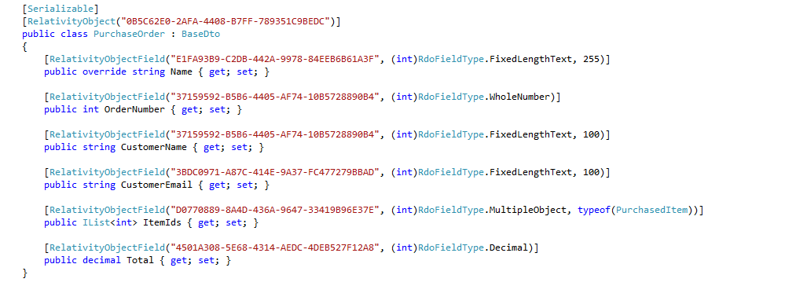
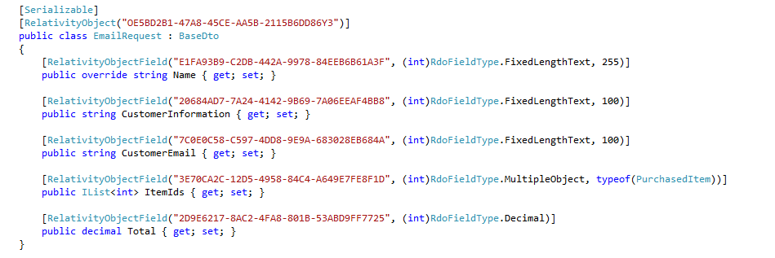
Example Models – PurchaseOrder & EmailRequest

Slide 29
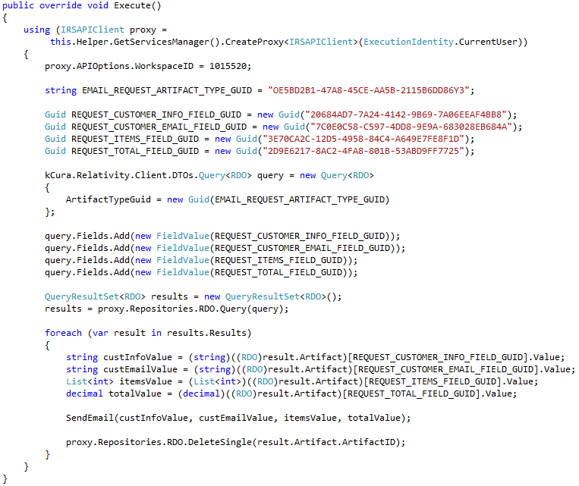
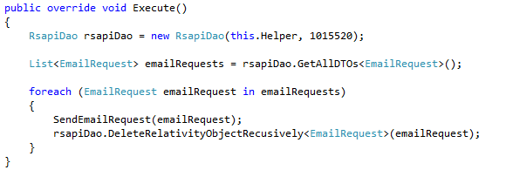
Before Gravity vs. After Gravity – (Agent Example)

Slide 30
Relativity Community (community.relativity.com)
Developer Group
DevHelp Community (devhelp.relativity.com)
RelativityDev GitHub (relativitydev.github.io)

Slide 33
Questions?

